Slide 1


Green Pace
Security Policy Presentation
Developer: James Jones

Slide 2

OVERVIEW: DEFENSE IN DEPTH
This security policy is meant to assist Green Pace in it’s transition from a DevOps organization to a DevSecOps organization placing a higher importance on secure coding practices. This security policies outlines the 10 secure coding principles and coding standards to help ensure these principles are followed. Defense-in-depth is the practice of applying security at multiple levels of a system. As a growing organization this security policy provides an outline of secure coding practices that can be used to train both newer and experienced team members, an essential step in defense-in-depth.

Slide 3
THREATS MATRIX
PROBABILITY | SEVERITY | Severity
 | LOW HARM | MEDIUM HARM | HIGH HARM
LIKELY | STD-008-CPP |  | STD-003-CPP STD-004-CPP STD-005-CPP
PROBABLE | STD-007-CPP STD-009-CPP | STD-002-CPP STD-010-CPP
UNLIKELY | STD-006-CPP | STD-001-CPP
This threat matrix shows the probability and severity of a security threat that these coding standards protect. Through the use of automated tools such as Clang, CodeSonar, and HelixQAC these issues can be easily caught and corrected.

Slide 4
10 PRINCIPLES
Validate Input Data
STD-002-CPP STD-004-CPP
Heed Compiler Warnings
STD-003-CPP STD-005-CPP STD-010-CPP
Architect and Design for Security Policies
STD-001-CPP STD-003-CPP STD-005-CPP STD-006-CPP STD-009-CPP
Keep it Simple
STD-002-CPP STD-009-CPP STD-010-CPP
Default Deny
STD-005-CPP
Adhere to the Principle of Least Privilege
Sanitize Data Sent to Other Systems
STD-004-CPP
Practice Defense-in-Depth
STD-006-CPP
Use Effective Quality Assurance Techniques
STD-005-CPP STD-006-CPP STD-007-CPP STD-008-CPP
Adopt a Secure Coding Standard
STD-001-CPP STD-002-CPP STD-004-CPP STD-006-CPP STD-007-CPP STD-008-CPP STD-009-CPP STD-010-CPP

Slide 5
CODING STANDARDS
Rule | Severity | Likelihood | Remediation Cost | Priority | Level
STD-003-CPP | High | Likely | Medium | High | 1
STD-004-CPP | High | Likely | Medium | High | 1
STD-005-CPP | High | Likely | Medium | High | 1
STD-002-CPP | Medium | Probable | Medium | Medium | 2
STD-010-CPP | Medium | Probable | Medium | Medium | 2
STD-001-CPP | Medium | Unlikely | Medium | Low | 3
STD-007-CPP | Low | Probable | Medium | Low | 3
STD-009-CPP | Low | Probable | Medium | Low | 3
STD-008-CPP | Low | Likely | Low | Medium | 2
STD-006-CPP | Low | Unlikely | High | Low | 3

Slide 6
ENCRYPTION POLICIES
Encryption at Rest – The practice of encrypting stored data. Techniques such as database encryption and file system encryption provide protection to stored data enhancing overall security.
Encryption in Flight – The practice of encrypting data travelling between points. Techniques such as email encryption and TLS keep data protected while being sent between points.
Encryption in Use – The practice of encrypting data that is actively being used. Encryption libraries and algorithms can be used to protect data while it is in use.

Slide 7
TRIPLE-A POLICIES
Authentication – The practice of confirming a user’s identity. This can be accomplished using a username and password. Two-factor authentication is a way to increase the level of security of both the users and the system.
Authorization – The practice of specifying the level of access and privileges a user has. Authorization enforces the policies of the system based on the level of access a user possesses.
Accounting – The practice of measuring resources the user accesses while using the system. This allows for auditing after security breaches to quickly find what the attacker may have accessed.

Slide 8
Unit Testing
Unit Testing – Unit testing is a way to test the components of a program to verify that the program behaves as expected. There are numerous tools that can be used for unit testing. The following examples use the Google test framework.

Slide 9
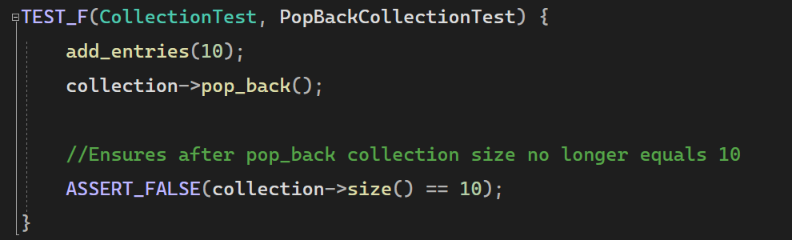
PopBackCollectionTest
In this test I was verifying the pop_back() function, by checking the size of the collection after calling pop_back().

Slide 10
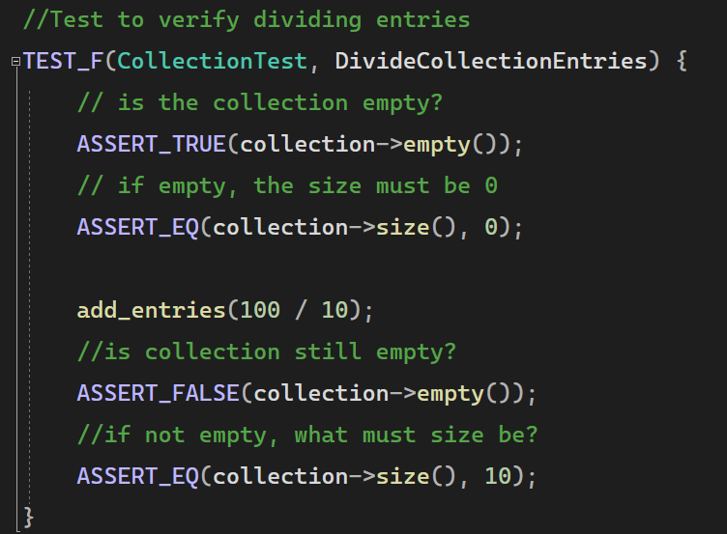
DivideCollectionEntries
In this test I was verifying that I could add entries using division. The test first ensures that the collection is empty this helps ensure I get the expected value. Then I added entries using division and then verified I had the correct number of entries.

Slide 11

AUTOMATION SUMMARY

Slide 12
TOOLS
DevSecOps brings security to equal footing with development, operations, and delivery.
Clang – is a front-end tooling infrastructure compiler for the C language family. Built specifically for better diagnostics, easy integrations with IDE’s, and as a flexible easy to maintain compiler. Clang can easily add automation to an application.
https://clang.llvm.org/
CPPCheck – is a static analysis tool for C/C++ and provides code analysis to detect bugs and specializes in undefined behavior and dangerous coding constructs. Cppcheck is capable of analyzing C/C++ code even if it has non-standard syntax.
http://cppcheck.net/

Slide 13
RISKS AND BENEFITS
Risk of Waiting:
Puts real world data at risk
Damage to reputation
Damage to users
Financial damages
Benefits of Acting Early:
Little to no real world data is at risk
Decrease risks of future attacks
Allows for establishment of approved coding standards
Eases testing

Slide 14
RECOMMENDATIONS
Potential Gaps in Security Policy:
One principle not adequately covered is the principle of least privilege this does fall under the Triple A’s specifically authorization.
The threat landscape is constantly evolving constant monitoring and updates to the security policy is the only way to maintain security.

Slide 15
CONCLUSIONS
The evolution to a DevSecOps practice can greatly increase the overall security of Green Pace. Following the best practices and coding standards outlined in this security policy will help in this transition. Applying defense-in-depth, bringing security to the foreground of development and using the triple A framework are crucial steps in creating a secure application. Together these will benefit Green Pace, the user base, and help improve/grow the Green Pace development team.

Slide 16
REFERENCES
Mylonas, L. (2018, November 27). What is AAA Security? an introduction to authentication, Authorisation and Accounting. Codebots. https://codebots.com/application-security/aaa-security-an-introduction-to-authentication-authorisation-accounting
Sibanda, I. (2023, August 14). Data in transit encryption explained. phoenixNAP Blog. https://phoenixnap.com/blog/data-in-transit-encryption
Velimirovic, A. (2023a, November 1). Data Encryption at rest explained. phoenixNAP Blog. https://phoenixnap.com/blog/encryption-at-rest
Velimirovic, A. (2023b, November 16). Data Encryption in use explained. phoenixNAP Blog. https://phoenixnap.com/blog/encryption-in-use
What is DevSecOps?. Red Hat - We make open source technologies for the enterprise. (n.d.). https://www.redhat.com/en/topics/devops/what-is-devsecops

